Slide 1
Learning Resource Center
(Library)

Slide 2
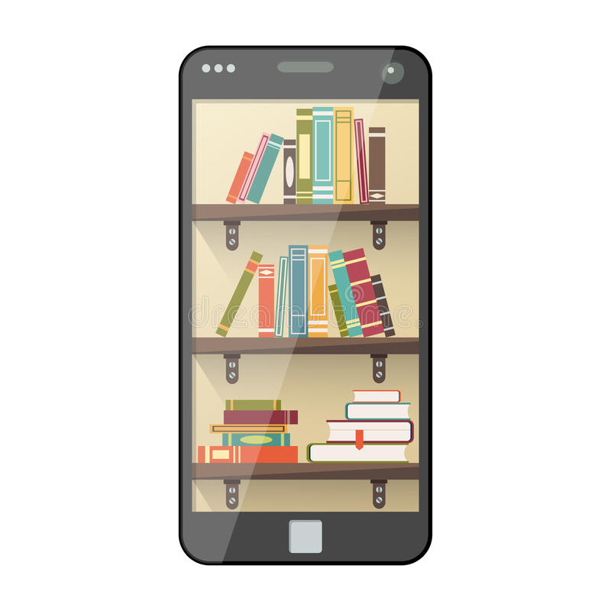
Access:
Remington College students have access to a variety of research materials at their fingertips.

Slide 3
Library Guidance:
The important aims of library guidance are
to ensure that users have access to their information needs, and to know that a Librarian is available to
assist and guide them in their research.

Slide 4
Library:
Definition of library
1a: a place in which literary, musical, artistic, or reference materials (such as books, manuscripts, recordings, or films) are kept for use but not for sale
https://www.merriam-webster.com/dictionary

Slide 5
Guidance:
Definition of guidance
1: the act or process of guiding
2: advice on vocational or educational problems given to students
https://www.merriam-webster.com/dictionary

Slide 6
Databases:
Resources:
You have access to several articles, books, and videos related to your program of study.
GALE
ProQuest
AVON (Academic Video Online)
Additional resources are also provided

Slide 7
Ebooks:
You have access to thousands of ebooks you can read from your phone, ipad, laptop, PC, etc..

Slide 8
Why Use the Library?
The library is designed as a place to support learning.
The online LRC databases greatly expand the learning experience.
There is a select range of literature from a variety of cultures.
Reading is our most valuable learning tool.

Slide 9
Why Ask the Librarian?
The Librarian is experienced in finding reliable information.
Librarians can assist with research and proper documentation.
A Librarian is available to assist you directly.
The Librarian stays up to date on Remington programs and supporting resources.

Slide 10
The Librarian is at your service:
To contact the Librarian directly,
please email Sean Shepherd at
sean.shepherd@remingtoncollege.edu
or call 817-880-0067

